Slide 1




A Theory of Stall Hysteresis
Why the reattachment angle is less than the separation stall angle
Thorne Wolfenbarger
Maria Babcock
Dr. Wallace Morris

Slide 2
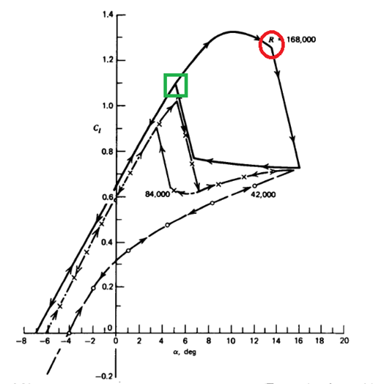


What is Stall Hysteresis?
Flow state depends on flow history
When an airfoil exceeds its stall angle and recovers at a lower AOA
Catastrophe Angle
(Stall Angle)
McCormick 1995 [18]
Sherman 1947 [20]

Slide 3
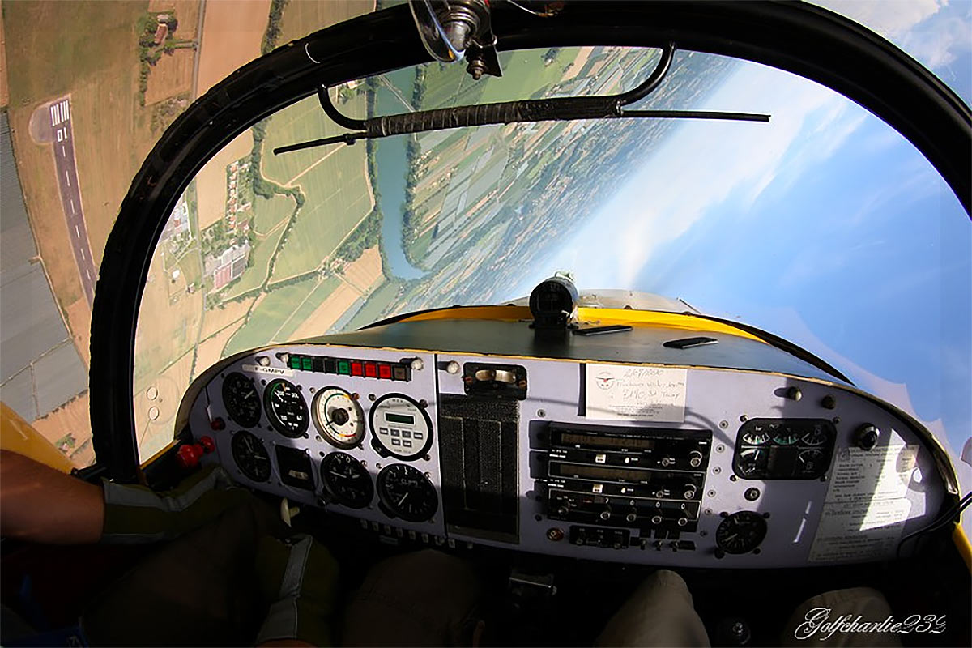
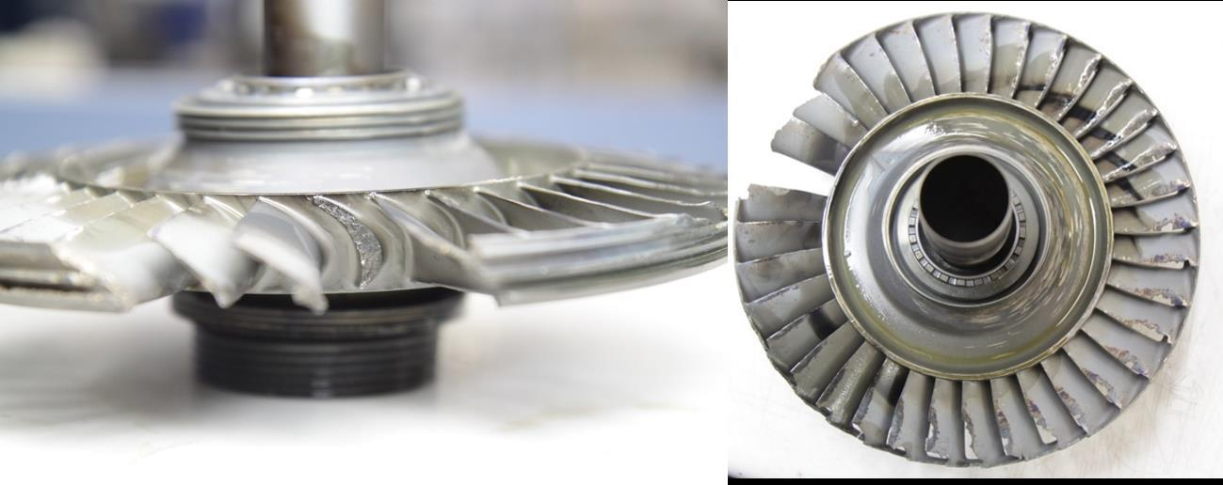
Why do we care?
Delay Fatigue Cracking
gc232
Increase Operational Envelope
[flightglobal]

Slide 4
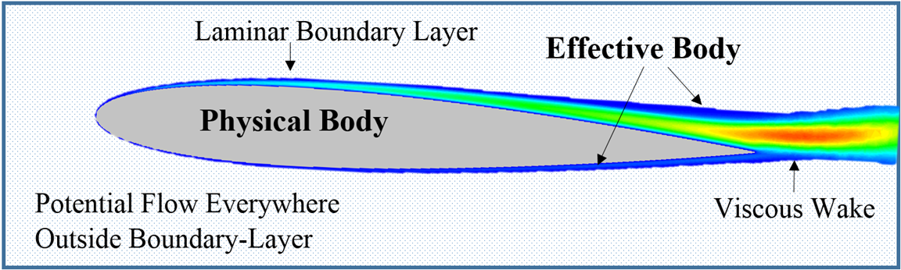
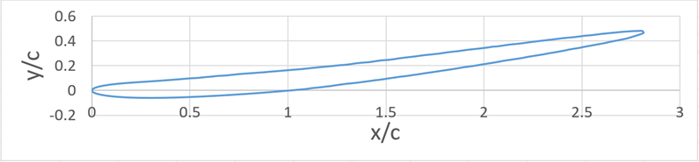
Hypothesis
The reattachment angle of a given airfoil geometry agrees with the stall/separation angle of its associated virtual/effective body.

Slide 5
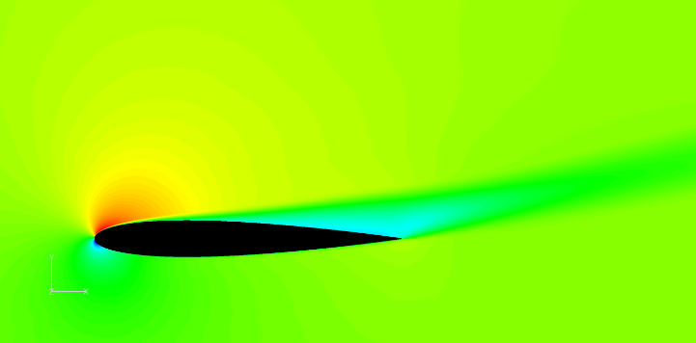
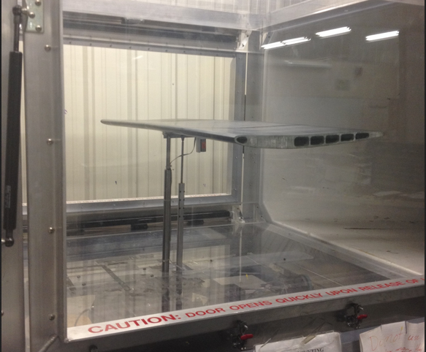
Methods
Computational
  Ansys Fluent
    NACA0012 to determine effective body
Experimental
  ERAU Doryland Windtunnel
    NACA0012
    Effective body

Slide 6
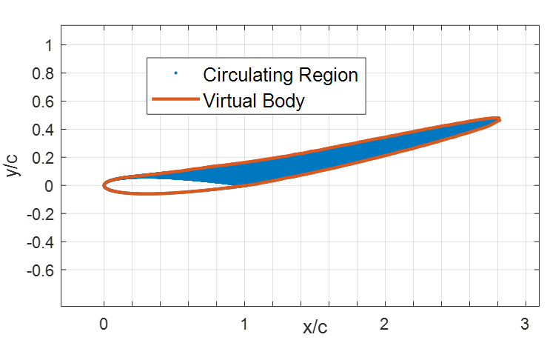
Methods - Computational
Increased chord
Target Re = 1.33M
Notes:
Effective Body outline for wind tunnel model
Note increase in chord and associated increase in chord-Re
Target Re = 1.33M based on physical body test

Slide 7
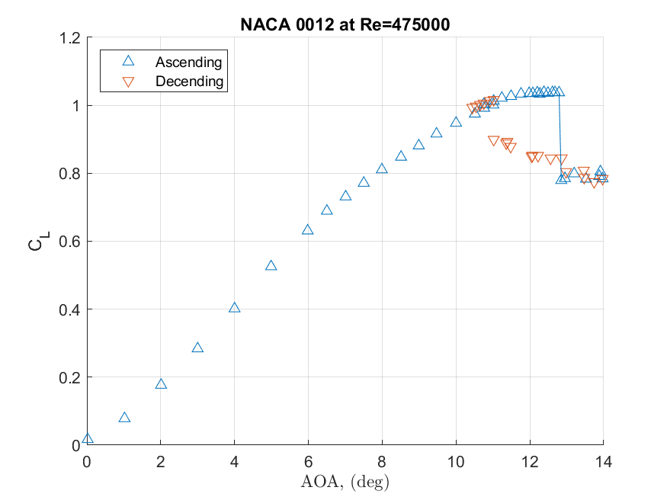
Methods - Experimental - NACA0012
Stall (13.3deg)
Recovery (11.5deg)
Notes:
Stall angle ~13.3(deg)
Reattachment angle ~11.5(deg)

Slide 8
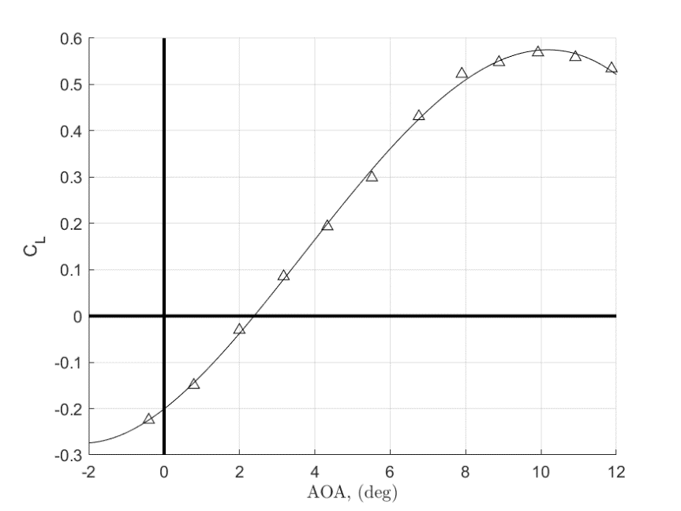
Methods - Experimental - Effective Body
Re = 750,000 (3/4M)
Stall (~10deg)

Slide 9
Results (thus far)
Effective Body Re=750000 (3/4M)
Notes:
The NACA0012 at Re = 475k reattaches (post stall) at ~ 11.5(deg)
The effective body could not be run at Re = 1.3M - only to 750k where the stall angle was about ten (10) degrees

Slide 10
Conclusions
More testing is still required to validate or refute the current hypothesis. However…
Understanding the mechanism for hysteresis may lead to predicting the size of the loop and, therefore, the ability to design around it!

Slide 11
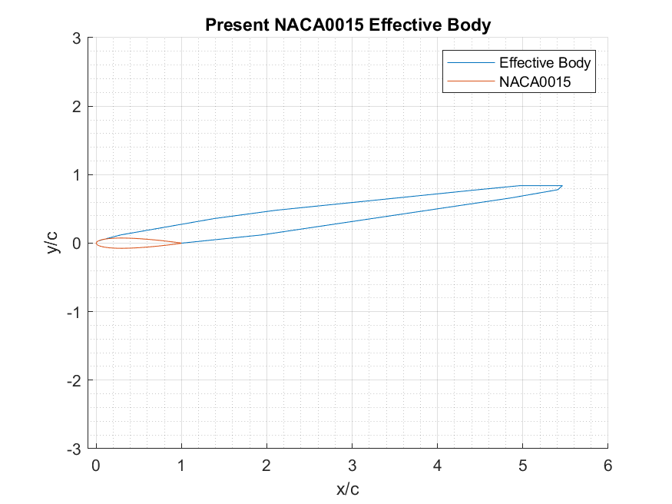
Present and Future Directions
Test Effective Body at Re=1.3M
Generate More Effective Bodies (e.g. NACA0015)

Slide 12

Questions?

Slide 13
References
[1] W.J. Morris II, Cole Zenker, Jesse Ingraham and Thorne Wolfenbarger, “A Theory of Stall Hysteresis – Why the reattachment angle is less than the separation stall angle”, AIAA Scitech Forum 2020 doi:10.2514/6.2020-1981
[2] W.J. Morris II & Z. Rusak, “Stall onset on aerofoils at low to moderately high Reynolds number flows,” J. Fluid Mech. (2013), vol. 733, pp. 439-472. doi:10.1017/jfm.2013.440
[3] J. Anderson, Fundamentals of Aerodynamics 5th Ed 2011, Chapter 3, McGraw-Hill
[4] Z. Yang, H. Igarashi, M. Martin and H. Hu, “An Experimental Investigation on Aerodynamic Hysteresis of a Low-Reynolds Number Airfoil,” AIAA Aerospace Sciences Meeting, AIAA-2008-0315
[5] D. Crider & J. Foster, “Simulation Modeling Requirements for Loss-of-Control Accident Prevention of Turboprop Transport Aircraft,” AIAA Modeling and Simulation Technologies Conference, AIAA 2012-4569
[6] C.P. Butterfield, A.C. Hansen, D. Simms, G. Scott, “Dynamics Stall on Wind Turbine Blades,” 1991,
NREL TP-257-4510
[7] M. Arjomandi, and R. Kelso, “Estimation of Dynamic Stall on Wind Turbine Blades using an Analytical Model,” 18th Australasian Fluid Mechanics Conference, 2012
[8] Zhiping LI, Peng ZHANG, Tianyu PAN, Qiushi LI, Jian ZHANG, “Hysteresis behaviors of compressor rotating stall with cusp catastrophic model,” Chinese j. of Aeronautics, May 2018, vol 31, pp. 1075-1084. doi.org/10.1016/j.cja.2018.02.010
[9] Z. Rusak & W. Morris II, “Stall Onset on Airfoils at Moderately High Reynolds Number Flows,” ASME Journal of Fluids Engineering November 1, 2011
[10] Lighthill, M.J., “On Displacement Thickness,” Journal of Fluid Mechanics, Vol. 4, No. 4, 1958
[11] Traub, L.W., “Effects of Plain and Gurney Flaps on a Nonslender Delta Wing,” Journal of Aircraft, Vol. 56, No. 2, 2019
[12] Traub, L.W., “Experimental Investigation of a Morphable Biplane,” Journal of Aircraft, Vol. 49, No. 1, 2012
[13] Khare, A., Singh, A., Nokam, K., “Best Practices in Grid Generation for CFD Applications Using Hypermesh,” Computational Research Laboratories, Pune, Maharashtra, India
[14] Rumsey, C. L., Spalart, P. R., “Turbulence Model Behavior in Low Reynolds Number Regions of Aerodynamic Flowfields,” AIAA Journal, Vol. 47, No. 4, 2009
[15] Anderson, R.F., “The Aerodynamic Characteristics of Airfoils at Negative Angles of Attack,” National Advisory Committee for Aeronautics, Technical Note No. 412
[16] E. Jacobs & A. Sherman, “Airfoil Section Characteristics as Affected by Variations of the Reynolds Number,” NACA TR-586, 1937
[17] A. Mendelson, “Aerodynamic Hysteresis as a Factor in Critical Flutter Speed of Compressor Blades at Stalling Conditions”, J. Aeronautical Sciences, Vol. 16, No. 11 (1949), pp. 645-652. Doi.org/10.2514 8.11879
[18] B.W. McCormick, “Aerodynamics Aeronautics and Flight Mechanics,” Wiley and Sons, second edition, 1995, p.142, figure 3.81.
[19] I.H Abbott & A.E VonDoenhoff,, “Theory of Wing Sections,” 1958, 2nd Edition, Dover Press
[20] A. Sherman, “Interference of Wings and Fuselage from Test of 30 Combinations with Triangular and Elliptical Fuselages in the NACA Variable-Density Tunnel”, NACA TN 1272, 1947]

Slide 14
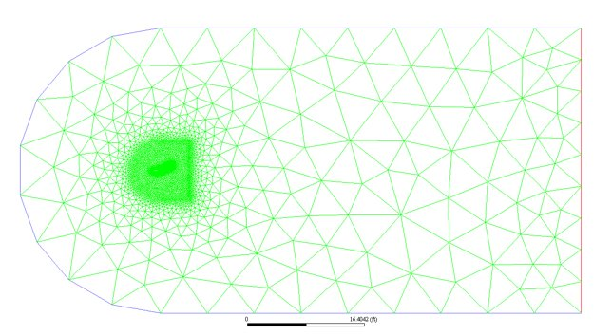
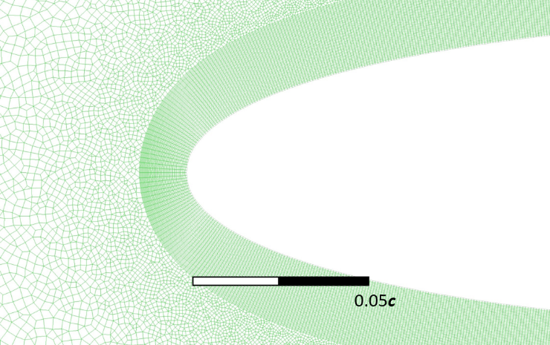
Backup Slides

